Slide 1
ECE 458 Overview and Expectations
ECE 457 Comments
The Design Process
ECE 458- Syllabus and Overview
Assignments
Plan and Schedule for Semester
Test Plan
Test Review
Final Report
Final Presentation
Notebooks

Slide 2
Feedback on ECE-457
Increased Class Time to Work on Projects
Addressed in ECE 458
Customer Expectations
Problem is Wide Range of Customer Expectations Based on Their Experience
Research Faculty with Very Limited Real World Experience
Industry Sponsors with Expectations Based on Experienced Employees
We Attempt to Familiarize Both Customer Types With Course Content and Expectations– Success Varies
The Range of Customer Expectations is One Reason That the Course Grading Scheme Looks the Way it Does
Team Selection
Mismatch Between Project Needs and Team Skills
Attempted to Articulate Skills Needed on Project Descriptions
All Students Select Projects vs. Team Leads Selecting
Inputs and Suggestions Welcome

Slide 3
Performance Evaluation Issues
Different Perspectives - Project vs. Technical; Academic vs. Industry
Different Grading Criteria and Expectations
Observation Space and Experience - Number of Projects Evaluated and Project Environment (Academic, Government, Industry)
Inconsistent Input - Numerical Grades on Grading Rubrics do not Match Suggested Final Grades
Qualitative vs. Quantitative Assessment
Bottom Line
The Above Reinforces the Importance of Specific, Quantitative, Requirements to Support Project and Team Evaluation
Performance Evaluation is Not an Exact Science
Criteria are Intentionally Not Specific for Professional Level Roles

Slide 4
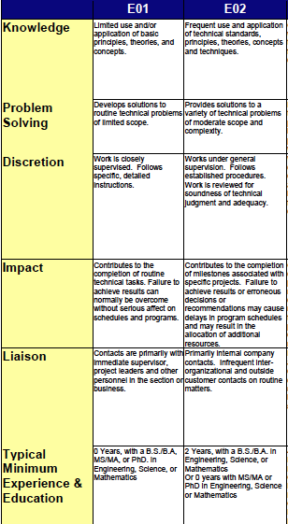
Examples of Evaluation Criteria for Professional Positions
Key Point is That the Criteria are Qualitative (i.e. Subjective) Not Quantitative
New Grad 1st Promotion
New Grad 1st Promotion

Slide 5
Differences Between ECE 457 and ECE 458
Only One Presentation- Final in Woodward Commons
Light Class Schedule => More Time to Work on Projects
Emphasis on Testing to Verify That Requirements are Met
Four Written Assignments
Plan and Schedule
Test Plan
Test Report
Final Report
Assignments Build on Each Other and Can be “Reused”
Weighting of Assignments is in Syllabus on m: ECE 458

Slide 6
Review of the Design Process
Requirements and Constraints
ECE 457
ECE 458
Customer
Need
Define Customer Need in Engineering Terms
Requirements
Review
with Customer
Develop and
Assess Candidate
Systems
Preliminary Design Review and
Preliminary Test
Plan Review
Requirements, Standards, Constraints
Requirements, Standards, Constraints
“Best” => System meets requirements and addresses constraints in most effective way
Design,
Build, and Test
Components
Plan and Schedule for
Detailed Design,
Integration, and Test
Select “Best” System Solution
Plan and Schedule
Final Report, Notebook, and Presentation
Test Plan
Test Report
Test Plan
Integrate
Components
& Continue Test
Test Review
Final
Presentation
& Report
Requirements, Standards, Constraints

Slide 7
Objectives for ECE 458
Develop a Realistic Plan and Schedule
Schedule and Tasks to Ensure Successful Completion of Design
Responsibility for Tasks
Develop a Test Plan To Effectively Test Your Design and Demonstrate that it Satisfies Requirements
Have a Successful Test Review
Summarize Progress Against Schedule and Requirements
Show How Requirements Have Been Met Based on Test Results
Discuss any Remaining Work, Issues, etc.
Submit a High Quality Final Report that Documents Your Project and Shows How Requirements Were Met
Submit a Professional Design Notebook
Give an Effective, Professional, Final Presentation and Demonstration

Slide 8
ECE 458 Assignments
Plan and Schedule for Semester
Test Plan
Test Report
Final Report and Presentation
Notebooks (2 evaluations 1st and last week of semester)

Slide 9
Report Generation
Fall Semester Status
Requirements from PDR
Requirements & System Updates
Plan & Schedule
Test Plan
Test Report
Final Report
Presentation
Test Cases
System Description from PDR
Test Results
Updates to Test Results
The Reports This Semester Are Designed to Enable You to Reuse Significant Amounts of Material. This Helps Ensure Consistency and Minimizes Administrative Effort Thus Providing More Time for Design and Test
Assignment
Reuse
New Input & Data

Slide 10
ECE 458 Syllabus Comments, Expectations, and Ground Rules
Engineering Notebooks
Requirements and Expectations are the Same as for ECE 457
Reports
Report grades will emphasize technical content; however clarity, organization, and professional formatting is still expected
Outlines, Page Counts, and Formats for Reports Will be Provided
Final Presentation
Presentation grades will emphasize clarity, organization, communication skills; grades for technical content will be derived from reports
Outlines, Time Constraints, and Presentation Guidelines Will be Provided
Grading- General Remarks
Assignment Weights are Shown in Syllabus
Grades Will be Strongly Influenced by Quality of Test Plan, Use of Test Plan and Presentation of Test Results to Show How Requirements are Met

Slide 11
ECE 458 Syllabus
Key Points in Syllabus
Grading Scheme
Overviews of Reports and Presentations
Notebook Requirements
Meetings with Faculty Advisors
Student Support

Slide 12
ECE 458 Schedule
Week | Date |  | Subject | Notes | Text Chapter
1 | 21-Jan | Tues | ECE 457- Grading and Comments Expectations for ECE 458 and Design Notebooks | SENG 222
1 | 23-Jan | Thurs | Requirements for Plan and Schedule | SENG 222
2 | 28-Jan | Tues | TBD | SENG 221
2 | 30-Jan | Thurs | TBD
3 | 4-Feb | Tues | Plan and Schedule Due | SENG 222
3 | 6-Feb | Thurs | Testing and Test Plans | SENG 222 | 7
4 | 11-Feb | Tues | Test Plan Examples | SENG 222 | 7
4 | 13-Feb | Thurs | Project Working Time and Questions and Help | SENG 221
5 | 18-Feb | Tues | NO CLASS- Following Monday Class Schedule
5 | 20-Feb | Thurs | Project Working Time and Questions and Help | SENG 221
6 | 25-Feb | Tues | Project Working Time and Questions and Help | SENG 221
6 | 27-Feb | Thurs | Test Plans Due
7 | 3-Mar | Tues | Project Working Time and Questions and Help | SENG 222
7 | 5-Mar | Thurs | Test Plan Discussion | SENG 221
8 | 10-Mar | Tues | NO CLASS --Spring Break
8 | 12-Mar | Thurs | NO CLASS --Spring Break
9 | 17-Mar | Tues | Project Working Time and Questions and Help | SENG 222
Week | Date |  | Subject | Notes | Text Chapter
9 | 19-Mar | Thurs | Class to Review Progress and Schedule for Rest of Semester | SENG 222
10 | 24-Mar | Tues | Project Working Time and Questions and Help
10 | 26-Mar | Thurs | Test Reports Due
11 | 31-Mar | Tues | Project Working Time and Questions and Help
11 | 2-Apr | Thurs | Test Report Feedback Final Report Directions | SENG 222 | 12
12 | 7-Apr | Tues | Project Working Time and Questions and Help |  | 12
12 | 9-Apr | Thurs | Final Presentation Directions | SENG 222 | 12
13 | 14-Apr | Tues | Project Working Time and Questions and Help |  | 12
13 | 16-Apr | Thurs | Final Report and Presentation Update (1) | SENG 222 | 12
14 | 21-Apr | Tues | Project Working Time and Questions and Help |  | 12
14 | 23-Apr | Thurs | Final Report and Presentation Update Team Evaluations Course Evaluation | SENG 222 | 12
15 | 28- Apr | Tues | FINAL REPORTS, DESIGN NOTEBOOKS, and PRESENTATIONS DUE BY 4:00 PM | SENG 222
15 | 30-Apr | Thurs | FINAL PRESENTATIONS | Library Reading Room

Slide 13
Engineering Notebooks
General Characteristics of Professional Notebooks
CONTENT
CONTINUITY
COMPLETENESS
FORMAT
Content
Not simply a log for meeting minutes!
Design Calculations
Graphs, Data, Diagrams (Hand or computer-generated)
Research on and Analysis of Design Options and Ideas
Test design and Test Results
Software Information and Listings
Continuity
Should Show Evidence of Consistent Effort Toward Project Completion (e.g. Daily, Weekly, Bi-weekly)
Completeness
Should Contain Enough Information and Detail For Another Knowledgeable Engineer to Understand the Project, the Design Decisions Made, Their Performance, and Their Contribution to the Overall Design
Format
Cover should have: Name and Contact Information; Project Name; Dates Covered
Pages Should be Numbered, Blank Pages Acknowledged, and Dates Shown on Each Page
In Industry, (but not here) there is typically a requirement that entries be witnessed by another engineer.

Slide 14
Plan and Schedule
Plan and Schedule MUST Include
Schedule and Tasks for Completion of the Design
Task Name
Planned Start and End Date of Task
Estimated Total Hours for Task
Actual Start and End Date of Task
The Team Member Responsible for Completing Each Task
“All” is not a Team Member!
If Multiple Team Members Work on a Task Designate One Team Member Responsible for Its Completion.
Notes: Your Plan and Schedule is not simply an administrative task. It should be a “checklist” of everything that needs to be done to successfully complete your project and show that it meets your customer’s requirements.

Slide 15
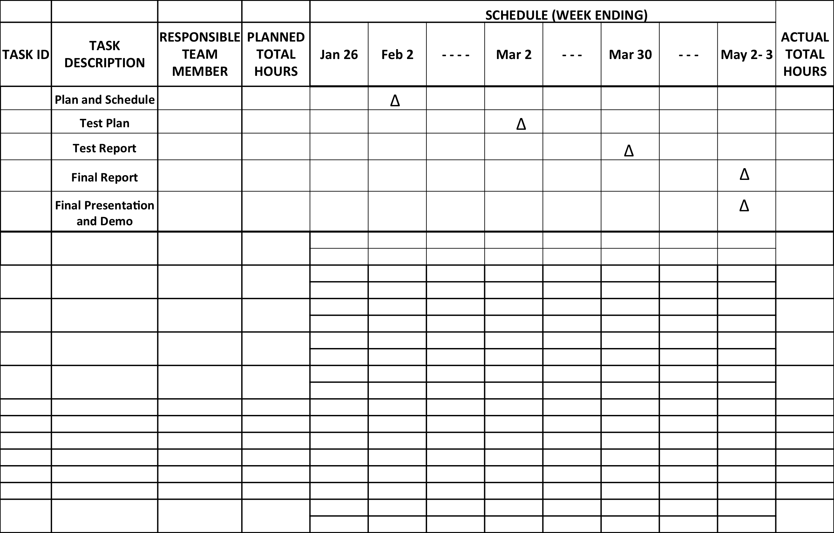
Plan and Schedule
Task XYZ
T1
Plan
T2
Actual

Slide 16
Test Plan
The test plan describes the tests you will conduct to verify each requirement. It documents the following:
Test equipment required
Software required
Location(s) of testing
Applicable requirements documents, software documentation, etc.
Test Cases describing the step-by-step instructions for verifying each requirement
A Verification Cross Reference Matrix (VCRM) that summarizes the tests
The test plan is the document that must be “passed” by the customer for the project to be successful. The results of executing the test plan will be the Test Report (see below)

Slide 17
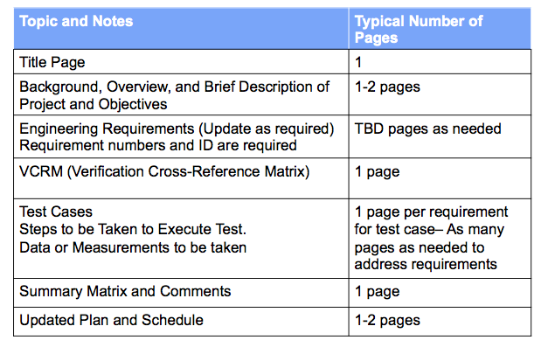
Test Plan Overview
Details of the Test Plan Will be Discussed in Class and Instructions Will be Provided

Slide 18
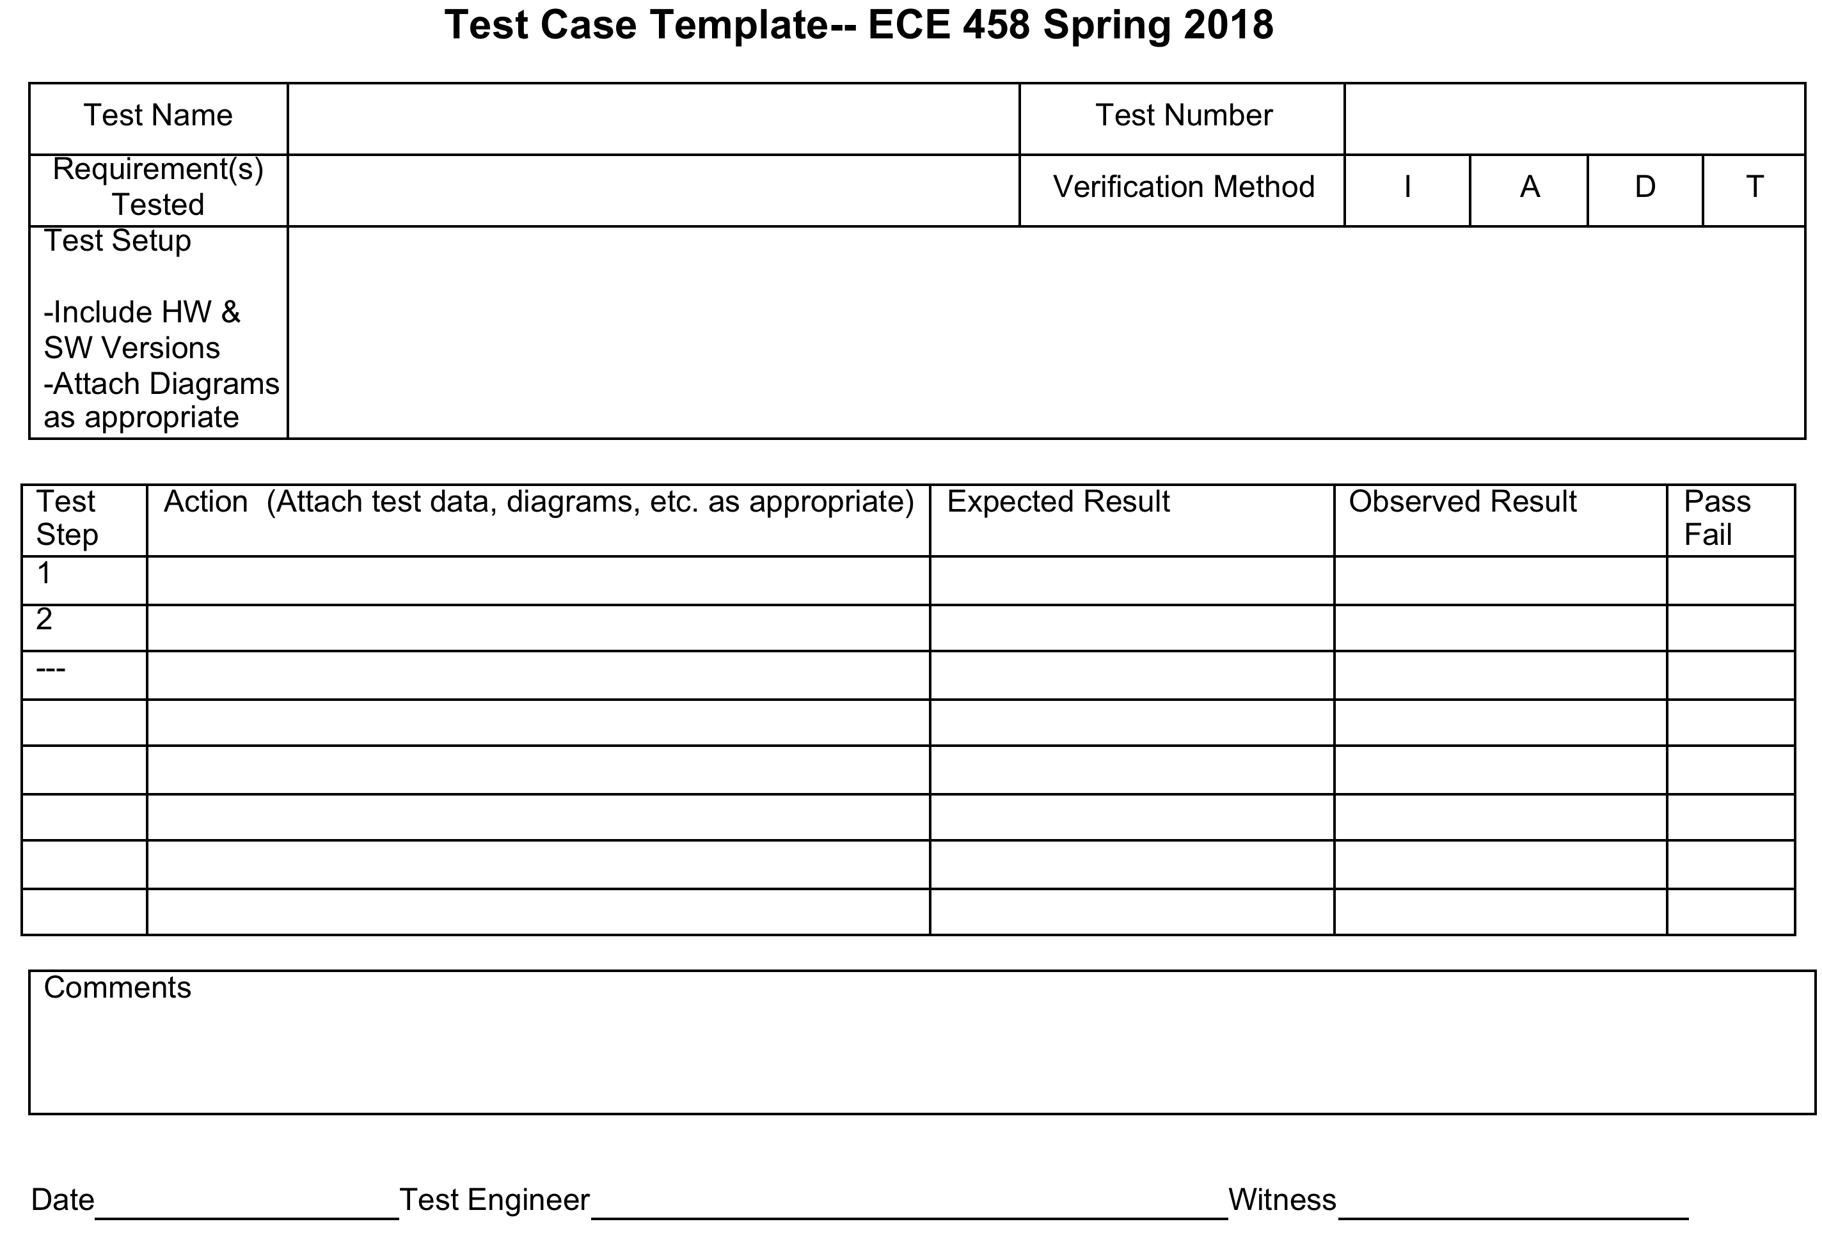
Test Case Overview

Slide 19
Test Report
The Test Report has Essentially the Same Format as the Test Plan
Results of the Tests are Added
Will Include any Updates to Requirements, Constraints, or the System Configuration as a Result of Information or Issues Identified During the Conduct of the Tests

Slide 20
Final Report
The Final Report is a Comprehensive Description of Your Project
Report Must Have Enough Detail and Data to Enable the Customer to:
Repair or Construct the System or its Individual Components if Needed
Assemble and Operate the System
The Outline of the Final Report is Shown on the Next Slide
More Detail and Directions Will be Provided in Class

Slide 21
Outline of Final Report
1. Project Overview
2. Customer Requirements
2.1. Requirements
3. Engineering Requirements, Constraints, and Applicable Standards
3.1. Requirements
3.2. Constraints
3.3. Standards / ethical issues
4. Functional Overview
5. Alternatives Evaluated
5.1. Alternative 1
5.2. Alternative 2
6. Technical Description of System
6.1. Detailed System Diagram
6.2. Subsystem 1 Description
6.3. Subsystem 2 Description
6.4. Subsystem N Description
7. Test Plan and Results
7.1. VCRM
7.2. Test Cases and Test Results
7.3. Test Summary
8. Risk Discussion
9. Plan, Schedule, and Costs
9.1. Plan and Schedule- Final Update
9.2. Actual Hours vs. Planned Hours
9.3. Cost Summary
10. Summary
11. Lessons Learned
12. Documentation (here or in Appendices)
12.1. Electrical
12.2. Software
12.3. Mechanical
12.4. Other (If Applicable)
Appendix A
Appendix B
Appendix C
Appendix N

Slide 22
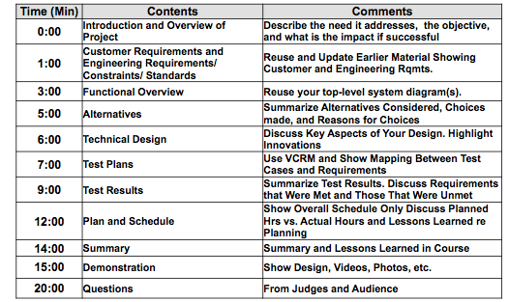
Presentation Overview
Presentations Will be Time-Limited => Need to Focus on Results and Key Points
We will Discuss Details of Presentations Later in Semester

